Slide 1
Computer Organization and Architecture
Module 2
Basic Operation of Computer Systems, Instruction Set & Addressing Modes, Instruction Encoding
Department of Computer Science and Engineering
IIT Kharagpur

Slide 2
Basic Block Diagram of a Computer System

Slide 3
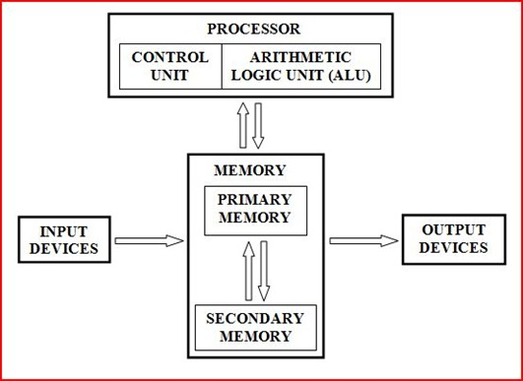
Simplified Block Diagram
All instructions and data are stored in memory.
An instruction and the required data are brought into the processor for execution.
Input / Output devices interface with the outside world.
Referred to as von-Neumann architecture.

Slide 4
Inside the Processor
  Also called Central Processing Unit (CPU).
  Consists of a Control Unit and an Arithmetic Logic Unit (ALU).
    All calculations happen inside the ALU.
    The Control Unit generates sequence of control signals to carry out all operations.
  The processor fetches an instruction from memory for execution.
    An instruction specifies the exact operation to be carried out.
    It also specifies the data that are to be operated on.

Slide 5
What is the role of ALU?
  It contains several registers, some general-purpose and some special-purpose, for temporary storage of data.
  It contains circuitry to carry out logic operations, like AND, OR, NOT, shift, compare, etc.
  It contains circuitry to carry out arithmetic operations like addition, subtraction, multiplication, division, etc.
  During instruction execution, the data (operands) are brought in and stored in some registers, the desired operation carried out, and the result stored back in some register or memory.

Slide 6
What is the role of control unit?
  Acts as the nerve center that senses the states of various functional units and sends control signals to control their states.
  To carry out a specific operation (say, R1 🡨 R2 + R3), the control unit must generate control signals in a specific sequence.
    Enable the outputs of registers R2 and R3.
    Select the addition operation.
    Store the output of the adder circuit into register R1.
  When an instruction is fetched from memory, the operation (called opcode) is decoded by the control unit, and the control signals issued.

Slide 7
Inside the Memory Unit
  Two main types of memory subsystems:
    Primary or Main memory, which stores the active instructions and data for the program being executed on the processor.
    Secondary memory, which is used as a backup and stores all active and inactive programs and data, typically as files.
  The processor only has direct access to the primary memory.
  In reality, the memory system is implemented as a hierarchy of several levels.
    L1 cache, L2 cache, L3 cache, primary memory, secondary memory.
    Objective is to provide faster memory access at affordable cost.

Slide 8
  Various different types of memory are possible.
    Random Access Memory (RAM), which is used for the cache and primary memory sub-systems. Read and Write access times are independent of the location being accessed.
    Read Only Memory (ROM), which is used as part of the primary memory to store some fixed data that cannot be changed.
    Magnetic Disk, which uses direction of magnetization of tiny magnetic particles on a metallic surface to store data. Access times vary depending on the location being accessed, and is used as secondary memory.
    Flash Memory or Solid-State Drives (SSD), which is replacing magnetic disks as secondary memory devices. They are faster, but smaller in size as compared to disk.

Slide 9
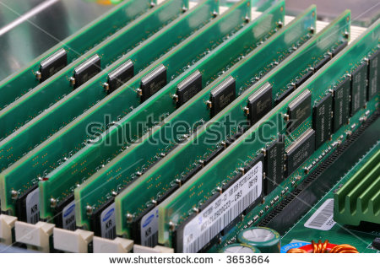
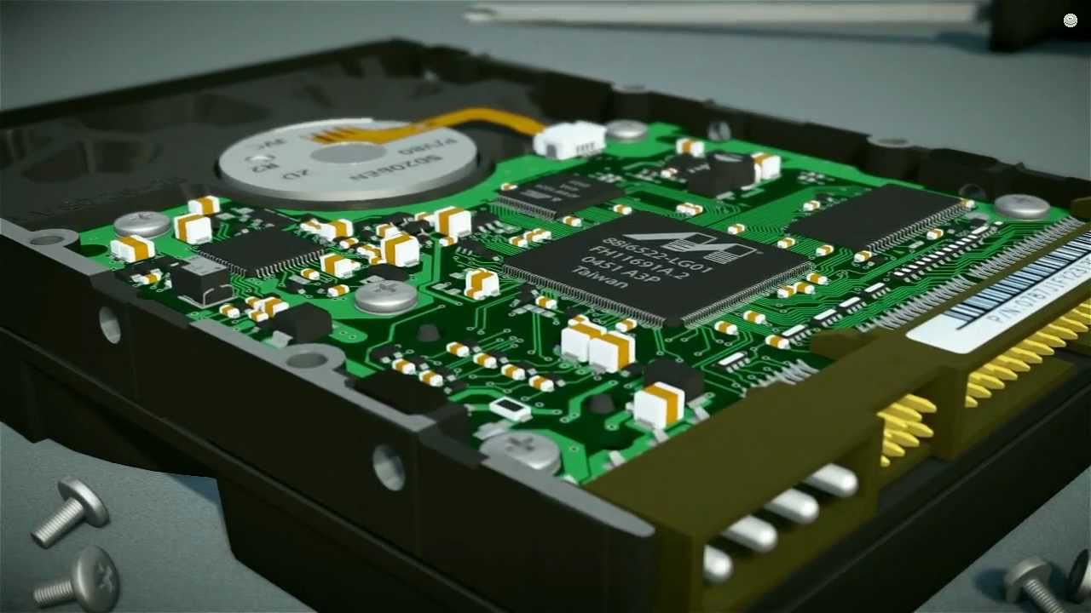
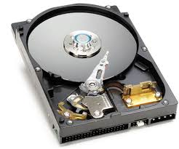
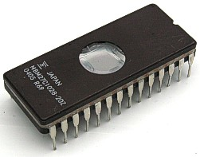

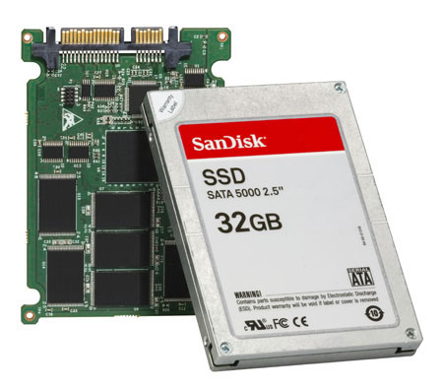


Slide 10
Input Unit
Used to feed data to the computer system from the external environment.
  Data are transferred to the processor/memory after appropriate encoding.
Common input devices:
  Keyboard
  Mouse
  Joystick
  Camera

Slide 11
Output Unit
Used to send the result of some computation to the outside world.
Common output devices:
  LCD/LED screen
  Printer and Plotter
  Speaker / Buzzer
  Projection system

Slide 12
Basic Operation of a Computer

Slide 13
Introduction
The basic mechanism through which an instruction gets executed shall be illustrated.
May be recalled:
  ALU contains a set of registers, some general-purpose and some special-purpose.
  First we briefly explain the functions of the special-purpose registers before we look into some examples.

Slide 14
For Interfacing with the Primary Memory
Address
Two special-purpose registers are used:
  Memory Address Register (MAR): Holds the address of the memory location to be accessed.
  Memory Data Register (MDR): Holds the data that is being written into memory, or will receive the data being read out from memory.
Memory considered as a linear array of storage locations (bytes or words) each with unique address.
0
1
2
3
4
5
1023
Memory

Slide 15
PROCESSOR
MA R
Address
PRIMARY
MEMORY
MD R
Data
Control Signals

Slide 16
To read data from memory
  Load the memory address into MAR.
  Issue the control signal READ.
  The data read from the memory is stored into MDR.
To write data into memory
  Load the memory address into MAR.
  Load the data to be written into MDR.
  Issue the control signal WRITE.

Slide 17
For Keeping Track of Program / Instructions
Two special-purpose registers are used:
  Program Counter (PC): Holds the memory address of the next instruction to be executed.
    Automatically incremented to point to the next instruction when an instruction is being executed.
  Instruction Register (IR): Temporarily holds an instruction that has been fetched from memory.
    Need to be decoded to find out the instruction type.
    Also contains information about the location of the data.

Slide 18
Overall Architecture of a Simple Processor
Memory
MAR
MDR
Control
R₀
PC
R₁
Processor
.
.
ALU
IR
R_{n-1}
n General Purpose Registers (GPR)

Slide 19
Example Instructions
We shall illustrate the process of instruction execution with the help of the following two instructions:
  ADD R1, LOCA
    Add the contents of memory location LOCA (i.e. address of the memory location is LOCA) to the contents of register R1.
    R1 🡨 R1 + Mem[LOCA]
  ADD R1, R2
    Add the contents of register R2 to the contents of register R1.
    R1 🡨 R1 + R2

Slide 20
Execution of ADD R1,LOCA
Assume that the instruction is stored in memory location 1000, the initial value of R1 is 50, and LOCA is 5000.
Before the instruction is executed, PC contains 1000.
Content of PC is transferred to MAR. MAR 🡨 PC
READ request is issued to memory unit.
The instruction is fetched to MDR. MDR 🡨 Mem[MAR]
Content of MDR is transferred to IR. IR 🡨 MDR
PC is incremented to point to the next instruction. PC 🡨 PC + 4
The instruction is decoded by the control unit.
ADD R1
5000

Slide 21
LOCA (i.e. 5000) is transferred (from IR) to MAR. MAR 🡨 IR[Operand]
READ request is issued to memory unit.
The data is fetched to MDR. MDR 🡨 Mem[MAR]
The content of MDR is added to R1. R1 🡨 R1 + MDR
The steps being carried out are called micro-operations:
  MAR 🡨 PC
  MDR 🡨 Mem[MAR]
  IR 🡨 MDR
  PC 🡨 PC + 4
  MAR 🡨 IR[Operand]
  MDR 🡨 Mem[MAR]
  R1 🡨 R1 + MDR

Slide 22
R1
50
125
PC = 1000
MAR = 1000
PC = PC + 4 = 1004
MDR = ADD R1, LOCA
IR = ADD R1, LOCA
MAR = LOCA = 5000
MDR = 75
R1 = R1 + MDR = 50 + 75 = 125
Address | Content
1000 | ADD R1, LOCA
1004 | …
5000
75
LOCA

Slide 23
Execution of ADD R1,R2
Assume that the instruction is stored in memory location 1500, the initial value of R1 is 50, and R2 is 200.
Before the instruction is executed, PC contains 1500.
Content of PC is transferred to MAR. MAR 🡨 PC
READ request is issued to memory unit.
The instruction is fetched to MDR. MDR 🡨 Mem[MAR]
Content of MDR is transferred to IR. IR 🡨 MDR
PC is incremented to point to the next instruction. PC 🡨 PC + 4
The instruction is decoded by the control unit.
R2 is added to R1. R1 🡨 R1 + R2
ADD R1, R2

Slide 24
R1
50
250
R2
200
PC = 1500
MAR = 1500
PC = PC + 4 = 1504
MDR = ADD R1, R2
IR = ADD R1, R2
R1 = R1 + R2 = 250
Address | Instruction
1500 | ADD R1, R2
1504 | …

Slide 25
Bus Architecture
The different functional modules must be connected in an organized manner to form an operational system.
Bus refers to a group of lines that serves as a connecting path for several devices.
The simplest way to connect the functional unit is to use the single bus architecture.
  Only one data transfer allowed in one clock cycle.
  For multi-bus architecture, parallelism in data transfer is allowed.

Slide 26
System-Level Single Bus Architecture
Input
Output
Memory
Processor

Slide 27
System-Level Two-Bus Architecture
Processor
Memory
Output
Device
Input Device
I/O Processor

Slide 28
Single-Bus Architecture Inside the Processor
There is a single bus inside the processor.
  ALU and the registers are all connected via the single bus.
  This bus is internal to the processor and should not be confused with the external bus that connects the processor to the memory and I/O devices.
A typical single-bus processor architecture is shown on the next slide.
  Two temporary registers Y and Z are also included.
  Register Y temporarily holds one of the operands of the ALU.
  Register Z temporarily holds the result of the ALU operation.
  The multiplexer selects a constant operand 4 during execution of the micro-operation: PC 🡨 PC + 4.

Slide 29
Internal Processor Bus
PC
Instruction Decoding and Control Unit
Control signals
.
.
.
MEMORY
MAR
MDR
IR
4
Y
R0
Select
MUX
R1
.
.
.
Function select
ALU
Carry-in
R_{n-1}
Z

Slide 30
Multi-Bus Architectures
Modern processors have multiple buses that connect the registers and other functional units.
  Allows multiple data transfer micro-operations to be executed in the same clock cycle.
  Results in overall faster instruction execution.
Also advantageous to have multiple shorter buses rather than a single long bus.
  Smaller parasitic capacitance, and hence smaller delay.

Slide 31
Memory Addressing Concepts

Slide 32
Overview of Memory Organization
Memory is one of the most important sub-systems of a computer that determines the overall performance.
Conceptual view of memory:
  Array of storage locations, with each storage location having a unique address.
  Each storage location can hold a fixed amount of information (multiple of bits, which is the basic unit of data storage).
A memory system with M locations and N bits per location, is referred to as an M x N memory.
  Both M and N are typically some powers of 2.
  Example: 1024 x 8, 65536 x 32, etc.

Slide 33
Some Terminologies
Bit: A single binary digit (0 or 1).
Nibble: Collection of 4 bits.
Byte: Collection of 8 bits.
Word: Does not have a unique definition.
  Varies from one computer to another; typically 32 or 64 bits.

Slide 34
How is Memory Organized?
Memory is often byte organized.
  Every byte of the memory has a unique address.
Multiple bytes of data can be accessed by an instruction.
  Example: Half-word (2 bytes), Word (4 bytes), Long Word (8 bytes).
For higher data transfer rate, memory is often organized such that multiple bytes can be read or written simultaneously.
  Necessary to bridge the processor-memory speed gap.
  Shall be discussed later in detail.

Slide 35
How do we Specify Memory Sizes?
Unit | Bytes | In Decimal
8 bits (B) | 1 or 2⁰ | 10⁰
Kilobyte (KB) | 1024 or 2¹⁰ | 10³
Megabyte (MB) | 1,048,576 or 2²⁰ | 10⁶
Gigabyte (GB) | 1,073,741,824 or 2³⁰ | 10⁹
Terabyte (TB) | 1,099,511,627,776 or 2⁴⁰ | 10¹²
Petabyte (PB) | 2⁵⁰ | 10¹⁵
Exabyte (EB) | 2⁶⁰ | 10¹⁸
Zettabyte (ZB) | 2⁷⁰ | 10²¹

Slide 36
If there are n bits in the address, the maximum number of storage locations can be 2^{n}.
  For n=8, 256 locations.
  For n=16, 64K locations.
  For n=20, 1M locations.
  For n=32, 4G locations.
Modern-day memory chips can store several Gigabits of data.
  Dynamic RAM (DRAM).
MEMORY
Address (n bits)
Data (m bits)
RD
WR
EN

Slide 37
Address | Contents
0000 0000 | 0000 0000 0000 0001
0000 0001 | 0000 0100 0101 0000
0000 0010 | 1010 1000 0000 0000
:
:
1111 1111 | 1011 0000 0000 1010
An example: 2⁸ x 16 memory

Slide 38
Some Examples
A computer has 64 MB (megabytes) of byte-addressable memory. How many bits are needed in the memory address?
  Address Space = 64 MB = 2⁶ X 2²⁰ B = 2²⁶ B
  If the memory is byte addressable, we need 26 bits of address.
A computer has 1 GB of memory. Each word in this computer is 32 bits. How many bits are needed to address any single word in memory?
  Address Space = 1 GB = 2³⁰ B
  1 word = 32 bits = 4 B
  We have 2³⁰ / 4 = 2²⁸ words
  Thus, we require 28 bits to address each word.

Slide 39
Byte Ordering Conventions
Many data items require multiple bytes for storage.
Different computers use different data ordering conventions.
  Low-order byte first
  High-order byte first
Thus a 16-bit number 11001100 00101010 can be stored as either:
Data Type | Size (in Bytes)
Character | 1
Integer | 4
Long integer | 8
Floating-point | 4
Double-precision | 8
Typical data sizes
11001100
00101010
or
00101010
11001100

Slide 40
The two conventions have been named as:
  Little Endian
    The least significant byte is stored at lower address followed by the most significant byte. Examples: Intel processors, DEC alpha, etc.
    Same concept followed for arbitrary multi-byte data.
  Big Endian
    The most significant byte is stored at lower address followed by the least significant byte. Examples: IBM’s 370 mainframes, Motorola microprocessors, TCP/IP, etc.
    Same concept followed for arbitrary multi-byte data.

Slide 41
An Example
Represent the following 32-bit number in both Little-Endian and Big-Endian in memory from address 2000 onwards:
    01010101 00110011 00001111 11000011
Little Endian
Address | Data
2000 | 11000011
2001 | 00001111
2002 | 00110011
2003 | 01010101
Big Endian
Address | Data
2000 | 01010101
2001 | 00110011
2002 | 00001111
2003 | 11000011

Slide 42
Memory Access by Instructions
The program instructions and data are stored in memory.
  In von-Neumann architecture, they are stored in the same memory.
  In Harvard architecture, they are stored in different memories.
For executing the program, two basic operations are required.
  Load: The contents of a specified memory location is read into a processor register. LOAD R1, 2000
  Store: The contents of a processor register is written into a specified memory location. STORE 2020, R3

Slide 43
An Example
Compute S = (A + B) – (C – D)
  LOAD R1,A
  LOAD R2,B
  ADD R3,R1,R2 // R3 = A + B
  LOAD R1,C
  LOAD R2,D
  SUB R4,R1,R2 // R4 = C – D
  SUB R3,R3,R4 // R3 = R3 – R4
  STORE S,R3

Slide 44
Classification of Computer Architecture
Broadly can be classified into two types:
  Von-Neumann architecture
  Harvard architecture
How is a computer different from a calculator?
  They have similar circuitry inside (e.g. for doing arithmetic).
  In a calculator, user has to interactively give the sequence of commands.
  In contrast, a computer works using the stored-program concept.
  Write a program, store it in memory, and run it in one go.

Slide 45
Von-Neumann Architecture
Instructions and data are stored in the same memory module.
More flexible and easier to implement.
Suitable for most of the general purpose processors.
General disadvantage:
  The processor-memory bus acts as the bottleneck.
  All instructions and data are moved back and forth through the pipe.
Processor
Program / Data
Memory

Slide 46
Harvard Architecture
Separate memory for program and data.
  Instructions are stored in program memory and data are stored in data memory.
Instruction and data accesses can be done in parallel.
Some microcontrollers and pipelines with separate instruction and data caches follow this concept.
The processor-memory bottleneck remains.
Processor
Program
Memory
Data Memory

Slide 47
Instruction Set Architecture

Slide 48
Introduction
Instruction Set Architecture (ISA)
  Serves as an interface between software and hardware.
  Typically consists of information regarding the programmer’s view of the architecture (i.e. the registers, address and data buses, etc.).
  Also consists of the instruction set.
Many ISA’s are not specific to a particular computer architecture.
  They survive across generations.
  Classic examples: IBM 360 series, Intel x86 series, etc.

Slide 49
Instruction Set Design Issues
Number of explicit operands:
  0, 1, 2 or 3.
Location of the operands:
  Registers, accumulator, memory.
Specification of operand locations:
  Addressing modes: register, immediate, indirect, relative, etc.
Sizes of operands supported:
  Byte (8-bits), Half-word (16-bits), Word (32-bits), Double (64-bits), etc.
Supported operations:
  ADD, SUB, MUL, AND, OR, CMP, MOVE, JMP, etc.

Slide 50
Evolution of Instruction Sets
Accumulator based: 1960’s (EDSAC, IBM 1130)
Stack based: 1960-70 (Burroughs 5000)
Memory-Memory based: 1970-80 (IBM 360)
Register-Memory based: 1970-present (Intel x86)
Register-Register based: 1960-present (MIPS, CDC 6600, SPARC)
1: 1-address instructions:
ADD X 🡪 ACC = ACC + Mem[X]
3: 2- or 3-address instructions:
ADD A,B 🡪 Mem[A] = Mem[A] + Mem[B]
ADD A,B,C 🡪 Mem[A] = Mem[B] + Mem[C]
2: 0-address instructions:
ADD 🡪 TOS = TOS + NEXT
5: 3-address instructions:
ADD R1,R2,R3 🡪 R1 = R2 + R3
4: 2-address instructions:
LOAD R1,X 🡪 R1 = Mem[X]

Slide 51
Example Code Sequence for Z = X + Y
Stack machine:
PUSH X
PUSH Y
ADD
POP Z
The ADD instruction pops two elements from stack, adds them, and pushes back result.
Top Of Stack
ALU

Slide 52
Accumulator based machine:
LOAD X // ACC = Mem[X]
ADD Y // ACC = ACC + Mem[Y]
STORE Z // Mem[Z] = ACC
All instructions assume that one of the operands (and also the result) is in a special register called accumulator.
ACC
ALU
From memory

Slide 53
Registers
Register-Memory machine:
LOAD R2,X. // R2 = Mem[X]
ADD R2,Y // R2 = R2 + Mem[Y]
STORE Z,R2 // Mem[Z] = R2
One of the operands is assumed to be in register and another in memory.
ALU
From memory

Slide 54
Registers
Register-Register machine:
LOAD R1,X // R1 = Mem[X]
LOAD R2,Y // R2 = Mem[Y]
ADD R3,R1,R2 // R3 = R1 + R2
STORE Z,R3 // Mem[Z] = R3
Also called load-store architecture, as only LOAD and STORE instructions can access memory.
ALU

Slide 55
About General Purpose Registers (GPRs)
Older architectures had a large number of special purpose registers.
  Program counter, stack pointer, index register, flag register, accumulator, etc.
Newer architectures, in contrast, have a large number of GPRs.
Why?
  Easy for the compiler to assign some variables to registers.
  Registers are much faster than memory.
  More compact instruction encoding as fewer bits are required to specify registers.
  Many processors have 32 or more GPR’s.

Slide 56
COMPARISON BETWEEN VARIOUS ARCHITECTURE TYPES

Slide 57
(a) Stack Architecture
Example: Y = A / B – (A – C * B)
  PUSH A
  PUSH B
  DIV
  PUSH A
  PUSH C
  PUSH B
  MUL
  SUB
  SUB
  POP Y
Typical instructions:
  PUSH X, POP X
  ADD, SUB, MUL, DIV
TOS

Slide 58
(a) Stack Architecture
Example: Y = A / B – (A – C * B)
  PUSH A
  PUSH B
  DIV
  PUSH A
  PUSH C
  PUSH B
  MUL
  SUB
  SUB
  POP Y
Typical instructions:
  PUSH X, POP X
  ADD, SUB, MUL, DIV
TOS
A

Slide 59
(a) Stack Architecture
Example: Y = A / B – (A – C * B)
  PUSH A
  PUSH B
  DIV
  PUSH A
  PUSH C
  PUSH B
  MUL
  SUB
  SUB
  POP Y
Typical instructions:
  PUSH X, POP X
  ADD, SUB, MUL, DIV
TOS
B
A

Slide 60
(a) Stack Architecture
Example: Y = A / B – (A – C * B)
  PUSH A
  PUSH B
  DIV
  PUSH A
  PUSH C
  PUSH B
  MUL
  SUB
  SUB
  POP Y
Typical instructions:
  PUSH X, POP X
  ADD, SUB, MUL, DIV
TOS
A/B

Slide 61
(a) Stack Architecture
Example: Y = A / B – (A – C * B)
  PUSH A
  PUSH B
  DIV
  PUSH A
  PUSH C
  PUSH B
  MUL
  SUB
  SUB
  POP Y
Typical instructions:
  PUSH X, POP X
  ADD, SUB, MUL, DIV
TOS
B
C
A
A/B

Slide 62
(a) Stack Architecture
Example: Y = A / B – (A – C * B)
  PUSH A
  PUSH B
  DIV
  PUSH A
  PUSH C
  PUSH B
  MUL
  SUB
  SUB
  POP Y
Typical instructions:
  PUSH X, POP X
  ADD, SUB, MUL, DIV
TOS
B*C
A
A/B

Slide 63
(a) Stack Architecture
Example: Y = A / B – (A – C * B)
  PUSH A
  PUSH B
  DIV
  PUSH A
  PUSH C
  PUSH B
  MUL
  SUB
  SUB
  POP Y
Typical instructions:
  PUSH X, POP X
  ADD, SUB, MUL, DIV
TOS
A-B*C
A/B

Slide 64
(a) Stack Architecture
Example: Y = A / B – (A – C * B)
  PUSH A
  PUSH B
  DIV
  PUSH A
  PUSH C
  PUSH B
  MUL
  SUB
  SUB
  POP Y
Typical instructions:
  PUSH X, POP X
  ADD, SUB, MUL, DIV
TOS
A/B-(A-B*C)

Slide 65
(a) Stack Architecture
Example: Y = A / B – (A – C * B)
  PUSH A
  PUSH B
  DIV
  PUSH A
  PUSH C
  PUSH B
  MUL
  SUB
  SUB
  POP Y
Typical instructions:
  PUSH X, POP X
  ADD, SUB, MUL, DIV
TOS
Y = RESULT

Slide 66
(b) Accumulator Architecture
Example: Y = A / B – (A – C * B)
  LOAD C
  MUL B
  STORE D // D = C * B
  LOAD A
  SUB D
  STORE D // D = A – C * B
  LOAD A
  DIV B
  SUB D
  STORE Y
Typical instructions:
  LOAD X, STORE X
  ADD X, SUB X, MUL X, DIV X

Slide 67
(c) Memory-Memory Architecture
Example: Y = A / B – (A – C * B)
  DIV D,A,B
  MUL E,C,B
  SUB E,A,E
  SUB Y,D,E
  MOV D,A
  DIV D,B
  MOV E,C
  MUL E,B
  SUB A,E
  SUB D,A
  MOV Y,D
Typical instructions (3 operands):
  ADD X,Y,Z
  SUB X,Y,Z
  MUL X,Y,Z
Typical instructions (2 operands):
  MOV X,Y
  ADD X,Y
  SUB X,Y
  MUL X,Y

Slide 68
(d) Load-Store Architecture
Example: Y = A / B – (A – C * B)
  LOAD R1,A
  LOAD R2,B
  LOAD R3,C
  DIV R4,R1,R2
  MUL R5,R3,R2
  SUB R5,R1,R5
  SUB R4,R4,R5
  STORE Y,R4
Typical instructions:
  LOAD R1,X
  STORE Y,R2
  ADD R1,R2,R3
  SUB R1,R2,R3

Slide 69
Registers: Pros and Cons
The load-store architecture forms the basis of RISC ISA.
  We shall explore one such RISC ISA, viz. MIPS32.
Helps in reducing memory traffic once the memory data are loaded into the registers.
Compiler can generate very efficient code.
Additional overhead for save/restore during procedure or interrupt calls and returns.
  Many registers to save and restore.

Slide 70
INSTRUCTION FORMAT AND ADDRESSING MODES

Slide 71
Instruction Format
opcode
operand (s)
An instruction consists of two parts:-
  Operation Code or Opcode
    Specifies the operation to be performed by the instruction.
    Various categories of instructions: data transfer, arithmetic and logical, control, I/O and special machine control.
  Operand(s)
    Specifies the source(s) and destination of the operation.
    Source operand can be specified by an immediate data, by naming a register, or specifying the address of memory.
    Destination can be specified by a register or memory address.

Slide 72
Number of operands varies from instruction to instruction.
Also for specifying an operand, various addressing modes are possible:
  Immediate addressing
  Direct addressing
  Indirect addressing
  Relative addressing
  Indexed addressing, and many more.

Slide 73
Instruction Format Examples
opcode
Implied addressing: NOP, HALT
opcode
memory address
1-address: ADD X, LOAD M
opcode
memory address
memory address
2-address: ADD X,Y
opcode
register
memory address
Register-memory: ADD R1,X
opcode
register
register
register
Register-register: ADD R1,R2,R3

Slide 74
Addressing Modes
They specify the mechanism by which the operand data can be located.
Some ISA’s are quite complex and supports many addressing modes.
ISA’s based on load-store architecture are usually simple and support very limited number of addressing modes.
Various addressing modes exist:
  Immediate, Direct, Indirect, Register, Register Indirect, Indexed, Stack, Relative, Autoincrement, Autodecrement, Based, etc.
  Not all processors support all addressing modes.
  We shall briefly look at the common addressing modes and how they work.

Slide 75
(a) Immediate Addressing
The operand is part of the instruction itself.
  No memory reference is required to access the operand.
  Fast but limited range (because a limited number of bits are provided to specify the immediate data).
Examples:
  ADD #25 // ACC = ACC + 25
  ADDI R1,R2,42 // R1 = R2 + 42
opcode
immediate data

Slide 76
(b) Direct Addressing
The instruction contains a field that holds the memory address of the operand.
Examples:
  ADD R1,20A6H // R1 = R1 + Mem[20A6]
Single memory access is required to access the operand.
  No additional calculations required to determine the operand address.
  Limited address space (as number of bits is limited, say, 16 bits).
opcode
operand address

Slide 77
opcode
operand address
Memory
operand

Slide 78
(c) Indirect Addressing
The instruction contains a field that holds the memory address, which in turn holds the memory address of the operand.
Two memory accesses are required to get the operand value.
Slower but can access large address space.
  Not limited by the number of bits in operand address like direct addressing.
Examples:
  ADD R1,(20A6H) // R1 = R1 + (Mem[20A6])

Slide 79
opcode
operand address
Memory
operand
pointer

Slide 80
(d) Register Addressing
The operand is held in a register, and the instruction specifies the register number.
  Very few number of bits needed, as the number of registers is limited.
  Faster execution, since no memory access is required for getting the operand.
Modern load-store architectures support large number of registers.
Examples:
  ADD R1,R2,R3 // R1 = R2 + R3
  MOV R2,R5 // R2 = R5

Slide 81
opcode
register no
Register Bank
operand

Slide 82
(e) Register Indirect Addressing
The instruction specifies a register, and the register holds the memory address where the operand is stored.
  Can access large address space.
  One fewer memory access as compared to indirect addressing.
Example:
  ADD R1,(R5) // PC = R1 + Mem[R5]

Slide 83
opcode
register no
Register Bank
Memory
operand

Slide 84
(f) Relative Addressing (PC Relative)
The instruction specifies an offset of displacement, which is added to the program counter (PC) to get the effective address of the operand.
  Since the number of bits to specify the offset is limited, the range of relative addressing is also limited.
  If a 12-bit offset is specified, it can have values ranging from -2048 to +2047.
opcode
offset
ADDER
Memory
PC
operand

Slide 85
(g) Indexed Addressing
Either a special-purpose register, or a general-purpose register, is used as index register in this addressing mode.
The instruction specifies an offset of displacement, which is added to the index register to get the effective address of the operand.
Example:
  LOAD R1,1050(R3) // R1 = Mem[1050+R3]
Can be used to sequentially access the elements of an array.
  Offset gives the starting address of the array, and the index register value specifies the array element to be used.

Slide 86
opcode
index reg
offset
Register Bank
Memory
ADDER
operand

Slide 87
(h) Stack Addressing
Operand is implicitly on top of the stack.
Used in zero-address machines earlier.
Examples:
  ADD
  PUSH X
  POP X
Many processors have a special register called the stack pointer (SP) that keeps track of the stack-top in memory.
  PUSH, POP, CALL, RET instructions automatically modify SP.

Slide 88
Some Other Addressing Modes
Base addressing
  The processor has a special register called the base register or segment register.
  All operand addresses generated are added to the base register to get the final memory address.
  Allows easy movement of code and data in memory.
Autoincrement and Autodecrement
  First introduced in the PDP-11 computer system.
  The register holding the operand address is automatically incremented or decremented after accessing the operand (like a++ and a-- in C).

Slide 89
MIPS Instruction Encoding
All MIPS32 instructions can be classified into three groups in terms of instruction encoding.
  R-type (Register), I-type (Immediate), and J-type (Jump).
  In an instruction encoding, the 32 bits of the instruction are divided into several fields of fixed widths.
  All instructions may not use all the fields.
Since the relative positions of some of the fields are same across instructions, instruction decoding becomes very simple.

Slide 90
(a) R-type Instruction Encoding
Here an instruction can use up to three register operands.
  Two source and one destination.
In addition, for shift instructions, the number of bits to shift can also be specified.
31
26
25
21
20
16
15
11
10
6
5
0
opcode
rs
rt
rd
shamt
funct
6-bit opcode
Source register 1
Source register 2
Destination register
Shift amount
Opcode extension (additional functions)

Slide 91
Examples of R-type instructions:
  add $s1, $s2, $s3
  sub $t1, $s3, $s4
  sla $s1, $s2, 5 // shift left $s2 by 5 places, and store in $s1
  An example instruction encoding: add $t1, $s1, $s2
    Recall: $t1 is R9, $s1 is R17, and $s2 is R18.
    For “add”, opcode = 000000, and funct = 100000.
31
26
25
21
20
16
15
11
10
6
5
0
000000
10001
10010
01001
00000
100000

Slide 92
(b) I-type Instruction Encoding
Contains a 16-bit immediate data field.
Supports one source and one destination register.
31
26
25
21
20
16
15
0
opcode
rs
rt
Immediate Data
6-bit opcode
Source register 1
Destinationregister
16-bit immediate data

Slide 93
Examples of I-type instructions:
  lw $s1, 50($s5)
  sw $t1, 100($s1)
  addi $t0, $s1, 188
  beq $s1, $s2, Label // Label is encoded as a 16-bit offset relative to PC
  bne $s3, $zero, Label
  An example instruction encoding: lw $t1, 48($s1)
    Recall: $t1 is R9, $s1 is R17.
    For “lw”, opcode = 100011.
31
26
25
21
20
16
15
0
100011
10001
01001
0000000000110000

Slide 94
(c) J-type Instruction Encoding
Contains a 26-bit jump address field.
  Extended to 28 bits by padding two 0’s on the right.
Example: j Label
31
26
25
0
opcode
Immediate Data
6-bit opcode
26-bit jump address

Slide 95
A Quick View
Some instructions require two register operands rs & rt as input, while some require only rs.
Gets known only after instruction is decoded.
While decoding is going on, we can prefetch the registers in parallel.
  May or may not be required later.
31
26
25
21
20
16
15
11
10
6
5
0
R-type
opcode
rs
rt
rd
shamt
funct
31
26
25
21
20
16
15
0
I-type
opcode
rs
rt
Immediate Data
31
26
25
0
J-type
opcode
Immediate Data
Similarly, the 16-bit and 26-bit immediate data are retrieved and sign-extended to 32-bits in case they are required later.

Slide 96
Addressing Modes in MIPS32
Register addressing add $s1, $s2, $s3
Immediate addressing addi $s1, $s2, 200
Base addressing lw $s1, 150($s2)
  Content of a register is added to a “base” value to get the operand address.
PC relative addressing beq $s1, $s2, Label
  16-bit offset is added to PC to get the target address.
Pseudo-direct addressing j Label
  26-bit offset if shifted left by 2 bits and then added to PC to get the target address.

Slide 97
RISC and CISC Architecture

Slide 98
Broad Classification
Computer architectures have evolved over the years.
  Features that were developed for mainframes and supercomputers in the 1960s and 1970s have started to appear on a regular basis on later generation microprocessors.
Two broad classifications of ISA:
  Complex Instruction Set Computer (CISC)
  Reduced Instruction Set Computer (RISC)

Slide 99
CISC versus RISC Architectures
Complex Instruction Set Computer (CISC)
  More traditional approach.
  Main features:
    Complex instruction set
    Large number of addressing modes (R-R, R-M, M-M, indexed, indirect, etc.)
    Special-purpose registers and Flags (sign, zero, carry, overflow, etc.)
    Variable-length instructions / Complex instruction encoding
    Ease of mapping high-level language statements to machine instructions
    Instruction decoding / control unit design more complex
    Pipeline implementation quite complex

Slide 100
  CISC Examples:
    IBM 360/370 (1960-70)
    VAX-11/780 (1970-80)
    Intel x86 / Pentium (1985-present)
Only CISC instruction set that survived over generations.
Desktop PC’s / Laptops use these.
The volume of chips manufactured is so high that there is enough motivation to pay the extra design cost.
Sufficient hardware resources available today to translate from CISC to RISC internally.

Slide 101
Addressing Modes in VAX
Addressing Mode | Example | Micro-operation
Register direct | ADD R1,R2 | R1 = R1 + R2
Immediate | ADD R1,#15 | R1 = R1 + 15
Displacement | ADD R1,220(R5) | R1 = R1 + Mem[220+R5]
Register indirect | ADD R1,(R3) | R1 = R1 + Mem[R3]
Indexed | ADD R1,(R2+R3) | R1 = R1 + Mem[R2+R3]
Direct | ADD R1, (1000) | R1 = R1 + Mem[1000]
Memory indirect | ADD R1,@(R4) | R1 = R1 + Mem[Mem[R4]]
Autoincrement | ADD R1,(R2)+ | R1 = R1 + Mem[R2]; R2++
Autodecrement | ADD R1,(R2)- | R1 = R1 + Mem[R2]; R2--
Scaled | ADD R1,50(R2)[R3] | R1 = R1 + Mem[50+R2+R3*d]

Slide 102
Reduced Instruction Set Computer (RISC)
  Very widely used among many manufacturers today.
  Also referred to as Load-Store Architecture.
    Only LOAD and STORE instructions access memory.
    All other instructions operate on processor registers.
  Main features:
    Simple architecture for the sake of efficient pipelining.
    Simple instruction set with very few addressing modes.
    Large number of general-purpose registers; very few special-purpose.
    Instruction length and encoding uniform for easy instruction decoding.
    Compiler assisted scheduling of pipeline for improved performance.

Slide 103
  RISC Examples:
    CDC 6600 (1964)
    MIPS family (1980-90)
    SPARC
    ARM microcontroller family
Almost all the computers today use a RISC based pipeline for efficient implementation.
  RISC based computers use compilers to translate into RISC instructions.
  CISC based computers (e.g. x86) use hardware to translate into RISC instructions.

Slide 104
Results of a Comparative Study
A quantitative comparison of VAX 8700 (a CISC machine) and MIPS M2000 (a RISC machine) with comparable organizations was carried out in 1991.
Some findings:
  MIPS required execution of about twice the number of instructions as compared to VAX.
  Cycles Per Instructions (CPI) for VAX was about six times larger than that of MIPS.
  Hence, MIPS had three times the performance of VAX.
  Also, much less hardware is required to build MIPS as compared to VAX.

Slide 105
The Instruction Set Architecture (ISA): From CISC to RISC

Slide 106
Complex Instructions
The ISA for MIPS was simple.
Instead, we can have more complex instructions.
  Complex Instruction Set Computers (CISC)
  Motivation for designing CISC ISA is to provide an ISA that supports the complex operations and data structures of high level languages (HLLs).

Slide 107
Reasons for the CISC style
Lesser memory requirements: Memory technology was slow and also small. Complex instructions leads to programs which has lesser memory requirements.
Hardware based computations are faster than doing it in software:
  time is saved in fetching and decoding several instructions.

Slide 108
Examples
VAX-11/780 was an ultimate CISC processor in 1978, supported 22 addressing modes, and has a variable instruction size ranging from 2 to 57.
For example it has an autoincrement addressing mode:
  a single instruction can read data from memory, add to the content of a register, store it back in memory and increment the memory pointer.
  (R2)=(R2)+R1, R2=R2+1
  The Complex Instruction can be written as a group of simple instructions (like we have seen in MIPS ISA):
  R4=(R2) #load instruction, I-type
  R4=R4+R1 #add instruction, R-type
  (R2)=R4 #Store instruction, I-type
  R2=R2+1
  The CISC instruction may be faster than the 4 RISC instructions. But there are other costs, which needs to be investigated.

Slide 109
CISC vs RISC
 | CISC |  | RISC
Characteristics | VAX 11/780 | Intel 486 | MIPS R4000
Number of Instructions | 303 | 235 | 94
Addressing Modes | 22 | 11 | 1
Instruction Size (bytes) | 2-57 | 1-12 | 4
Number of general purpose registers | 16 | 8 | 32

Slide 110
The Problems of CISC: Why RISC?
Limited Usage of the Complex Instructions: Complex instructions were used much lesser than expected.
  Like, sortup reg1, reg2 is a complex instruction to arrange the array from address stored in reg1 to reg2 in a non-descending order is used quite less. Further, the corresponding way of doing the sort hardwired may not be the best way of doing so (the best sorting depends on the type of data).

Slide 111
The Problems of CISC: Why RISC?
Difficulty of Compilers: With the development of compilers, it was observed that compilers tend to synthesize codes that have simple instructions.
  Simple ISA also helps in writing efficient compilers.

Slide 112
The Problems of CISC: Why RISC?
Few Data Types: CISC ISA tends to have a variety of data structures, from simple data types to complex data structures.
Beneficial to design a system that supports simple data types efficiently, and from which the complex data types can be synthesized.

Slide 113
The Problems of CISC: Why RISC?
Simple Addressing Modes: CISC designs provide large number of addressing modes.
  support complex data structures
  provide flexibility to access operands
Inefficient Instruction Decoding:
  Problems arise because of variable instruction execution times, as the time depends on the location of the operands.
  Variable instruction length

Slide 114
Large Register Sets
Several researchers have studied the procedure calls in HLLs.
Study shows that C programs have 12 to 15% call/return instructions.
Of machine language instructions, it is around 30%.
Call/return instructions have around 50% memory references: memory is used for local variables, parameters, storing activation record.
Thus it is important to have proper support for call/return instructions.

Slide 115
Large Register Sets
Research shows that 1.25 % of the called procedure has more than six arguments.
More than 93% of them have less than six local variables.
These figures show that activation records are not large.
  If we have large number of registers one can avoid memory references for most procedure calls.

Slide 116
Combination of RISC and CISC
Modern processors, like the Intel Pentium tries to combine the advantages in a single machine.
Front end hardware translators are used that replaces CISC instructions with a sequence of one or more RISC instructions.

Slide 117
A Single Instruction Processor
How much can we simplify?
What is the ultimate RISC processor?
  URISC
If we neglect the input/output, interrupts, scheduling, and other such operations, for computations a single instruction is sufficient!
Thus extra instructions are added, only for performance.

Slide 118
What is the instruction?
The instruction does not need any opcode.
Capability to perform arithmetic is needed:
  so, we have two operands
  we re-use the second operand as the destination
  since, there is no load/store instructions, two memory addresses are needed:
    source1 and source2/destination
Further, we need conditional branches:
  thus the instruction also has a third address, which specifies the target address.
  The branch condition is specified, by using subtraction as the arithmetic operation, and using the sign of the result as the condition.

Slide 119
The URISC instruction
subtract operand1 from operand2, replace operand2 with the result, and jump to target address in case of negative result
label: urisc dest, src1, target
Note, that the opcode is not needed.

Slide 120
Exiting the program
The convention will be that the program execution starts at the memory location 1.
Branching to memory location 0, terminates the program.
We use the assembler directive, .word to name and initialize one word of memory to be used as an operand
  stop: .word 0

Slide 121
URISC program for move
stop: .word 0
start: urisc dest,dest,+1 #dest = 0
urisc temp,temp,+1 #temp=0
urisc src,temp, +1 #temp=-(src)
urisc temp,dest,+1 #dest=-(temp)
…

Slide 122
Assignments
ex1: uadd dest,src1,src2
ex2: uswap src1,src2
ex3: uj label
ubge: src1, src2, label #if (src1)≥(src2), goto label
ubeq: src1,src2,label #if (src1)=(src2), goto label
Use at1 and at2 as temporary registers for the assembler.

Slide 123
uadd
urisc at1, at1, +1 #at1 = 0
urisc src1,at1,+1 #at1 = -(src1)
urisc src2,at1,+1 #at1 = -(src1)-(src2)
urisc dest,dest,+1 #dest=0
urisc at1,dest,+1 #dest = -(at1)=(src1)+(src2)

Slide 124
Basic Operations
Instruction should execute
Subtract
Branch if less than equal
Memory Operations needed
Theorem states that any instruction that has
this capability can be used as an URISC instruction
Reference: The Ultimate Reduced Instruction Set Computer
Int.J.Elect.Enging Educ., Vol 25, pp 327-334

Slide 125
Motivation
How much can RISC be reduced to ?
Main idea was to a create a fast, simple computer
Simple Instructions means a simple hardware
and a faster clock
Eliminates the decode stages in other computers
URISC is extreme in simplicity

Slide 126
URISC is Turing Compatible
Being equivalent to a universal Turing machine essentially means being able to perform any computational task that takes finite input and returns finite output in finitely-many steps.
By creating other instructions based on subtract, branch if negative or equal it can be shown that URISC is Turing compatible.

Slide 127
Machine Level Interpretation
<L> : <A>, <B>, <P>
L: Instruction Label
P: Jump Target Label
A,B: References to the memory where the
operands are located.

Slide 128
Example Programs
SUB(A,B) // B ← B - A, no branch
  SUB:A,B,END
  END: …
SETZERO(A) // A ← 0
  SETZERO:A,A,END
  END: ...
ADD(A,B) // B ← A + B, Assumes T0 is set to 0
  ADD0:A,T0,ADD1
  ADD1:T0,B,END
  END: ...

Slide 129
Example Programs
MOVE(A,B) // B ← A Assumes T0 is set 0
  MOV0: B,B, MOV1
  MOV1: A,T0, MOV2
  MOV2: T0,B, END
  END: ...
JUMP(Target) // Unconditional Jump
  JUMP:T0,T0,Target

Slide 130
URISC is a Multicycle Processor
Takes 4 clock cycles to complete a single instruction.
During each clock cycle a different set of control signals is output from the control unit. These control signals effect the flow of data in the processor/datapath.
A counter counts what microinstruction we are on. For each value of the counter a different set of microinstructions is output.
At the end of the instruction (after microinstruction 4 or earlier) the counter is reset to 0, and execution of the next instruction begins

Slide 131
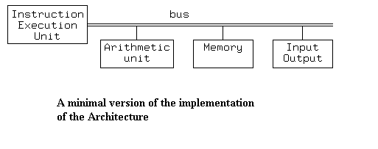
Hardware Implementation
  URISC hardware can be implemented in various forms best suited for optimizing one instruction

Slide 132
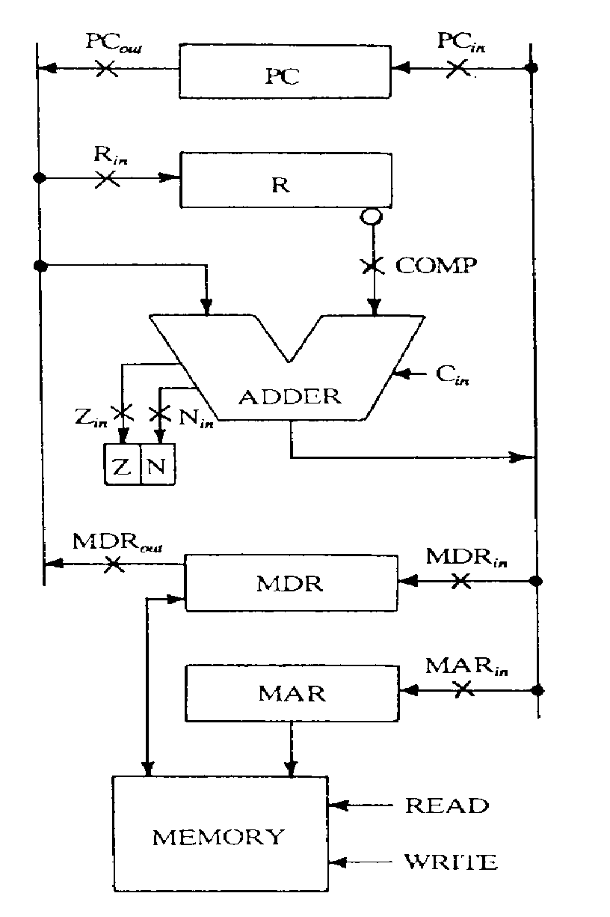
Hardware Implementation

Slide 133
Hardware Implementation
The URISC Computer uses minimal hardware.
To implement the instruction we need to:
  check to see if PC = 0
  load the first operand
  increment PC
  load the second operand
  subtract the operand
  store result in to the second operand
  increment PC
  load target
  increment PC
  if result is negative, set PC to target

Slide 134
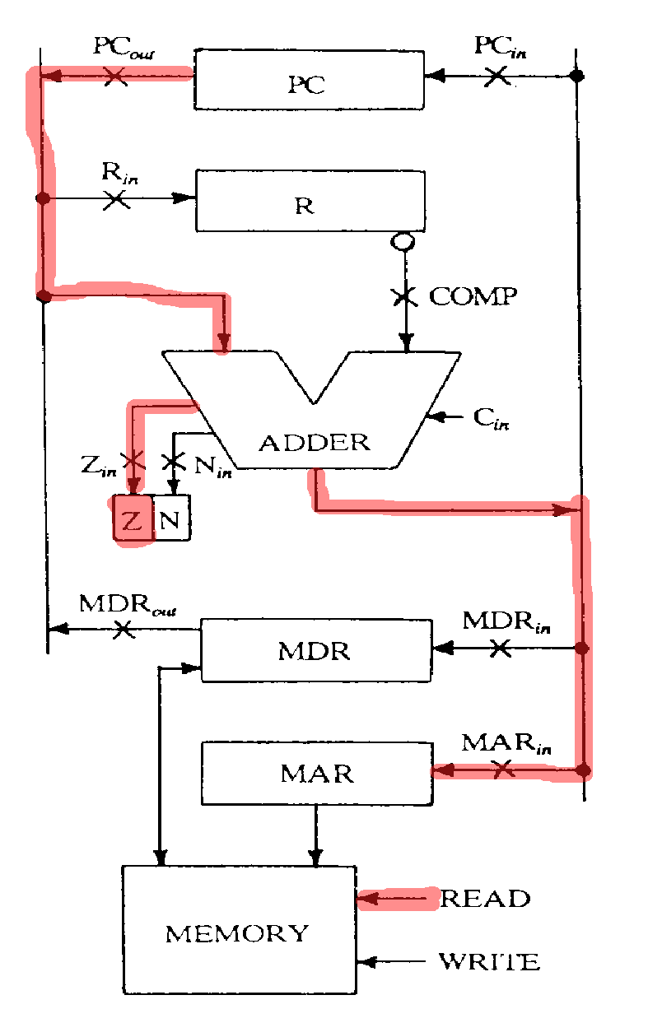
Cycle 1 – PC check to 0

Slide 135
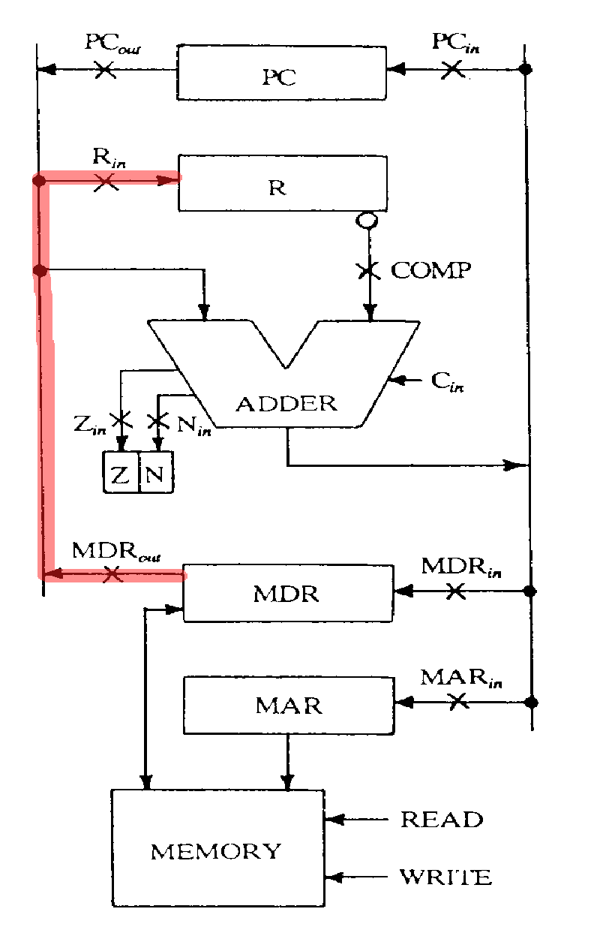
Cycle 2 Loading New Operand

Slide 136
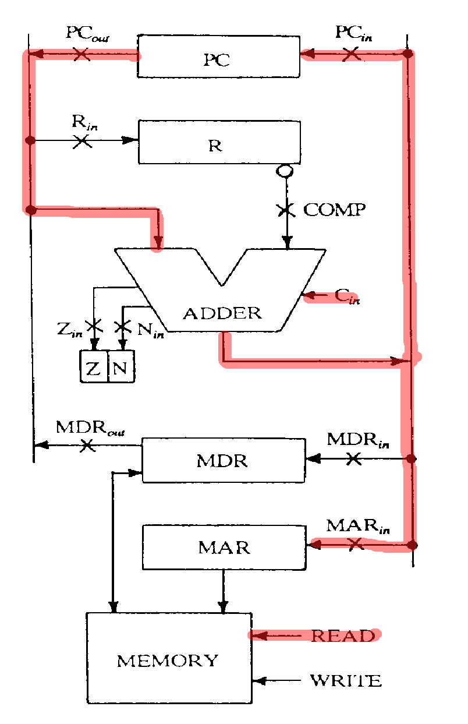
Cycle 3 PC Increment

Slide 137
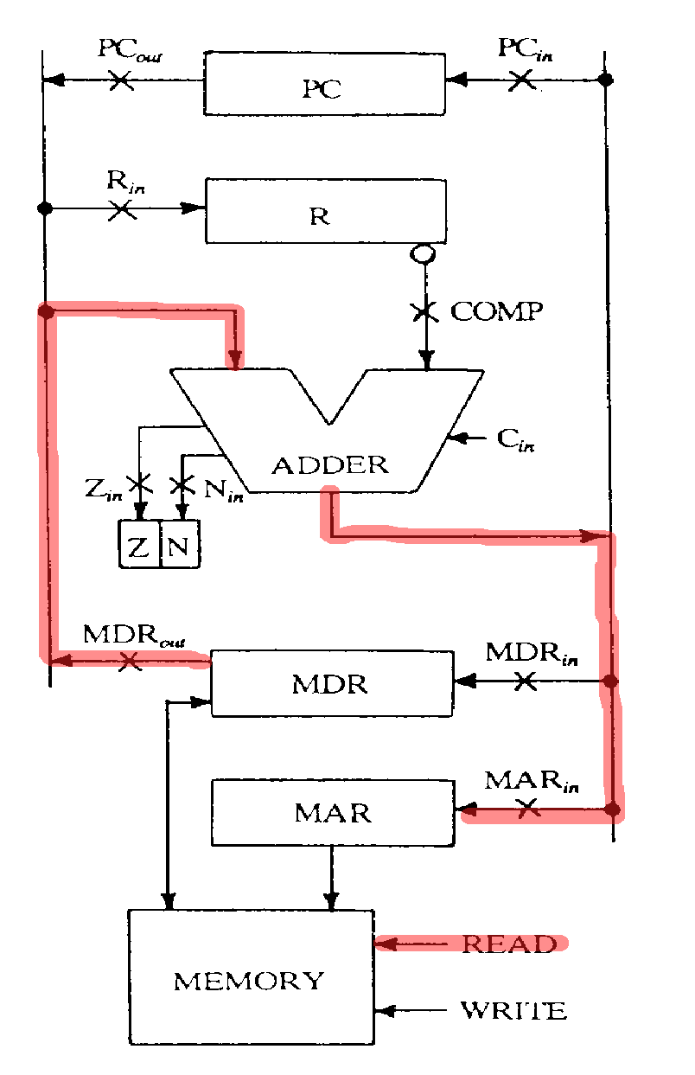
Cycle 4 Load Second Operand

Slide 138
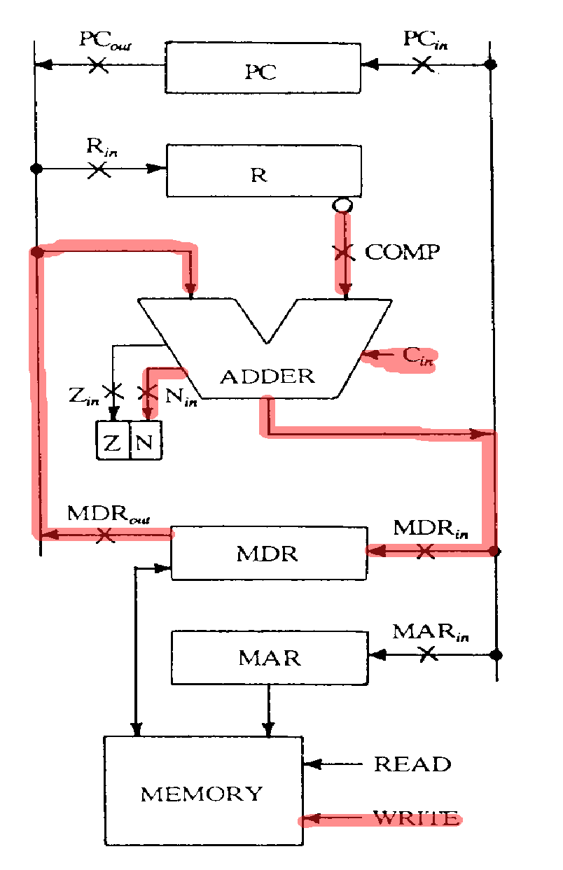
Cycle 5 Subtract and Store

Slide 139
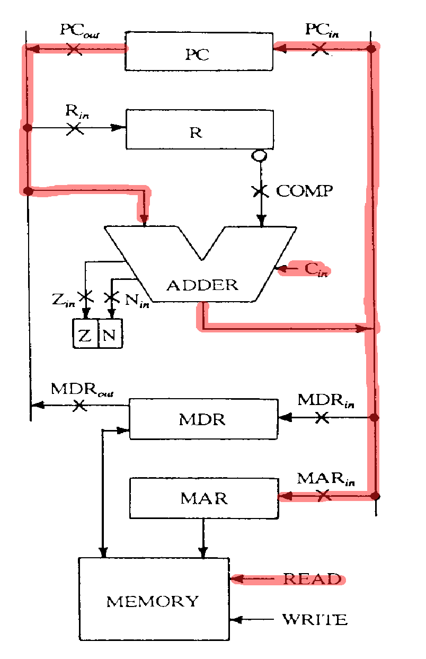
Cycle 6 Load Target

Slide 140
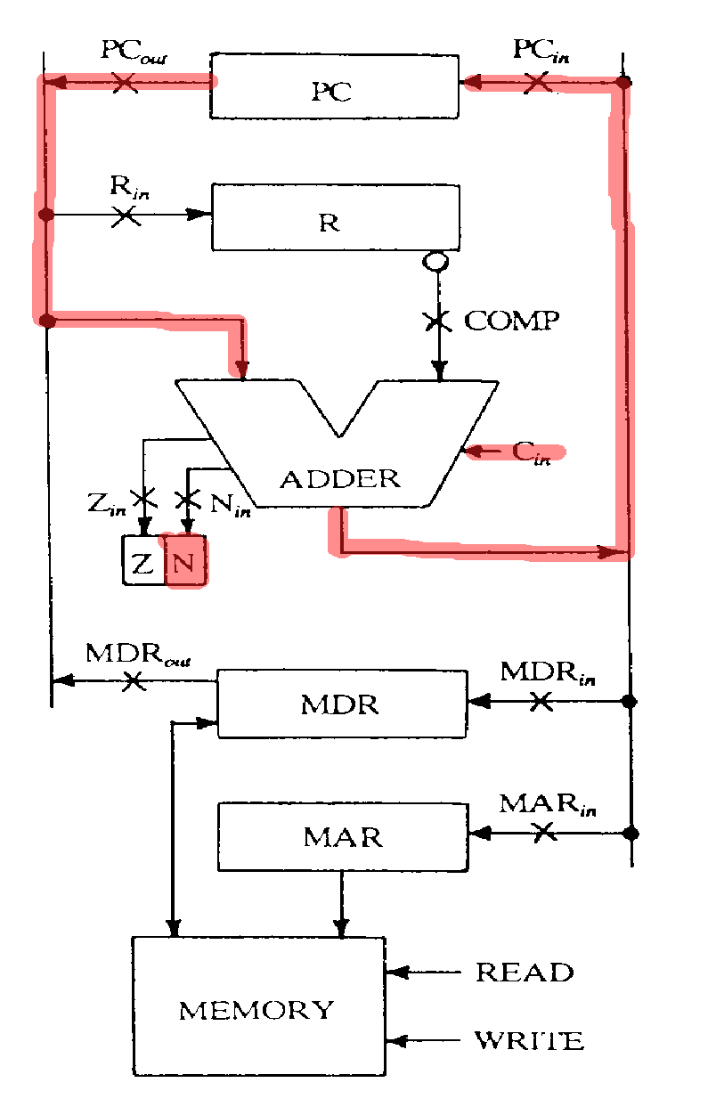
Cycle 7 Load target IF PC -ive

Slide 141
Problems with URISC
  URISC architecture is not competitive
  The cycles taken by URISC or the execution time per instruction is on an average 75% more than a MIPS multi-cycle architecture
  But that doesn’t prove it to be sub-optimal

Slide 142
Optimal Architectures
  Class of optimal architectures can be thought of as a surface in a multidimensional computer design space
  Taking typical axes of the space to be processor complexity the program size for some benchmark, and the memory traffic required to execute that benchmark, it’s clear that URISC fares worse than any other architecture

Slide 143
Optimal Architectures
  The minimal ultimate RISC can only be proven to be suboptimal if a processor can be found that is better when measured along at least one axis of the design space while being no worse along any other axes.

Slide 144
Work on URISC
  Steve Loughran formally defined, designed and built a 32-bit variant of this architecture as his final-year project at Edinburgh University in 1989
  Adam Donlin has proposed using an Ultimate RISC as a host for a dynamically reconfigurable FPGA coprocessor in "Self Modifying Circuitry -- A Platform for Trackable Virtual Circuitry" in Proceedings of FPL the 9th International Workshop, FPL⁹⁹, Springer-Verlag, ISSN 0302-9743, Aug 1999.

Slide 145
Work on URISC
  Paul Frenger wrote published a paper in ACM Sigplan Notices 35, 2 (Feb 2000) entitled "The Ultimate RISC: A Zero-Instruction Computer";
  ACM Computer Architecture News, 16, 3 (June 1988), pages 48-55.
  Univ. of Waterloo URISC: F. Mavaddat and B. Parhami, URISC: The Ultimate Reduced Instruction Set Computer

